Slide 1
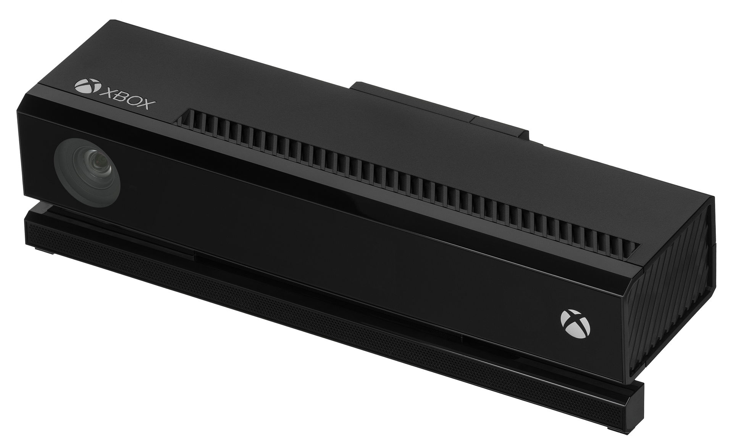
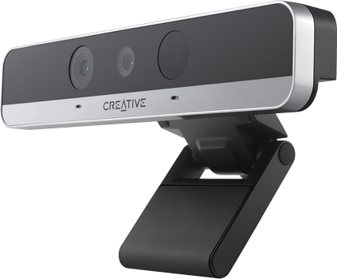
NUI e Biometrics in Windows 10

Slide 2




Andrea Sassetti
Software Engineer, Siemens
andreasassetti.wordpres.com
andrea.sassetti@live.it
@andreasassetti

Slide 3

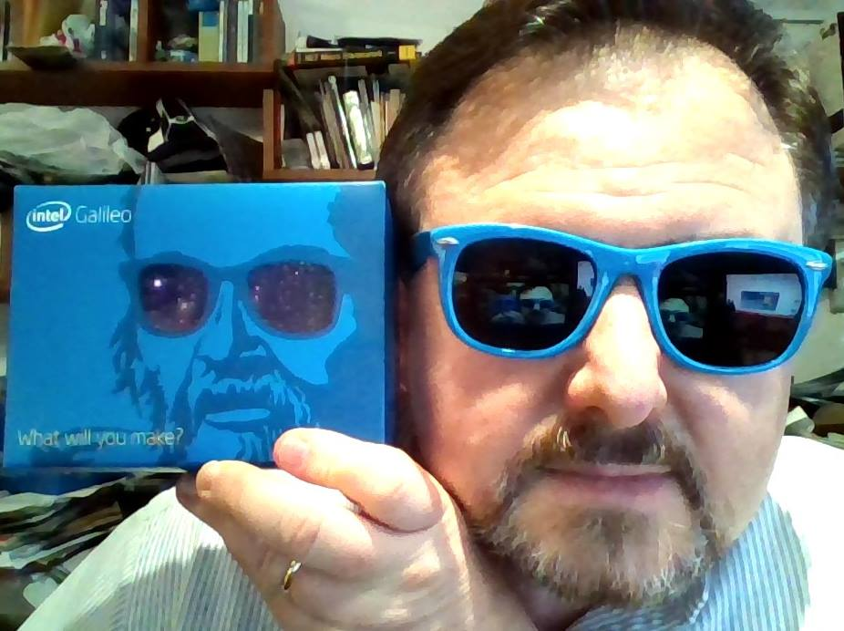



Marco Dal Pino
SW Eng - Consultant
mobileprog.com (ENG)
mobileprog.net (ITA)
Microsoft MVP
Intel Black Belt Software Developer
Intel Realsense Innovator Realsense & IoT
@MarcoDalPino
m.dalpino@dpcons.com
about.me/marcodalpino

Slide 4
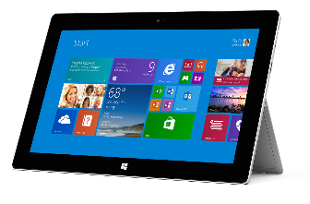
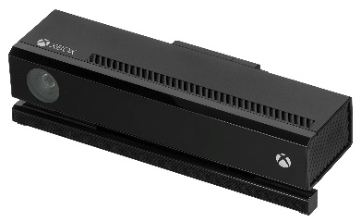

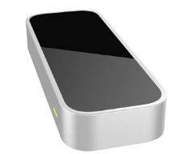
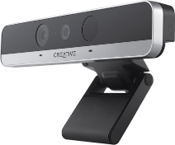
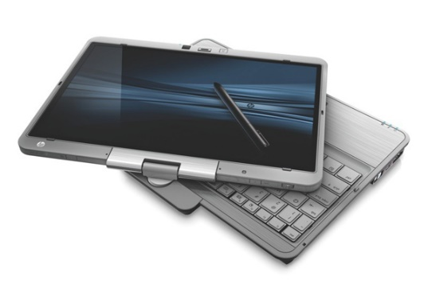
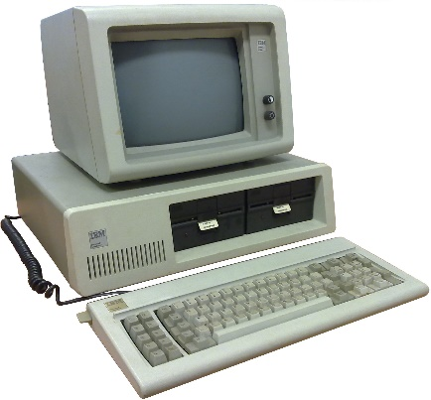
User interaction evolution
CLI
GUI
NUI

Slide 5
Natural User Interface
Use movements / gestures inherent in human nature or in the actions of every day
Rapid functionality learning
Can help people with disabilities to use the software

Slide 6
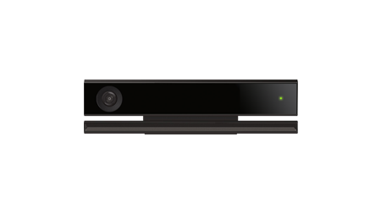
Microsoft Kinect v2
Kinect for Windows gives computers eyes, ears. With Kinect for Windows, businesses and developers are creating applications that allow their customers to interact naturally with computers by simply gesturing and speaking.

Slide 7
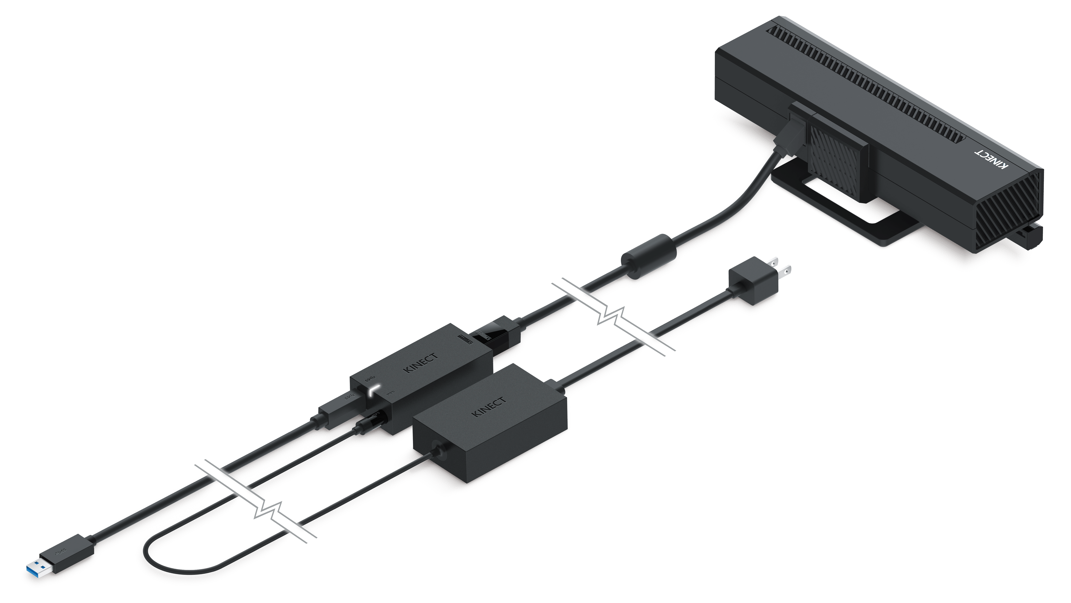
Kinect v2 - Sensor Components

Slide 8
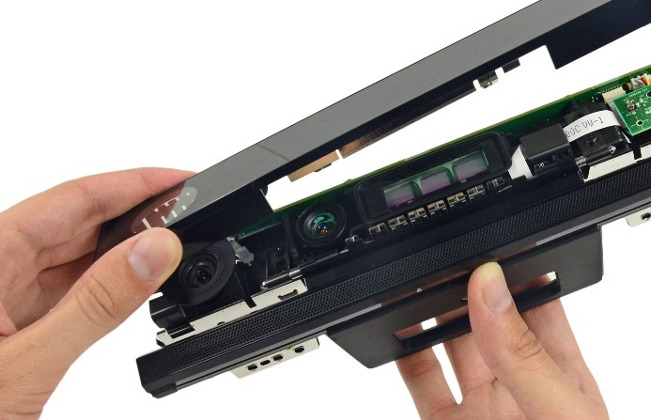
Kinect v2 - Sensor Components
Depth Sensor
Depth Sensor
Power Light
IR Emitters
IR Emitters
RGB Camera
Microphone Array

Slide 9
Kinect v2 - Hardware requirements
Physical dual-core 3.1 GHz (2 logical cores per physical) or faster
USB 3.0 port dedicated to the Kinect for Windows v2 sensor
2 GB of RAM
Graphics card that supports DirectX 11
Windows or Windows Embedded 8 or 8.1, 10
Kinect Configuration Verifier tool
http://go.microsoft.com/fwlink/?LinkID=513889

Slide 10
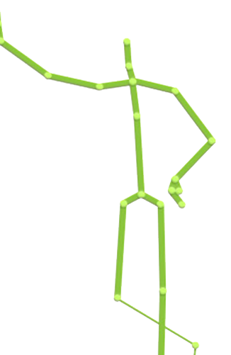
Kinect v2 - High level architecture
Native Apps
.NET
Apps
Windows Store Apps
C#, VB, JS, C++/CX
Native API
.NET
API
WinRT API
Kinect Runtime
Kinect Drivers
Physical Kinect Sensor

Slide 11
Kinect v2 - High level architecture
Kinect
Reader
Application
Kinect
Service
Source
Kinect
Reader
Application
Kinect
Reader
Application
Multiple Kinect-enabled applications can run simultaneously

Slide 12
Kinect v2 - High level architecture
PC
One connection
Multiple connection
PC
PC
HUB
SERVER
PC

Slide 13
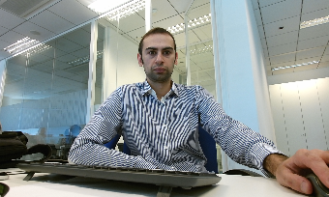
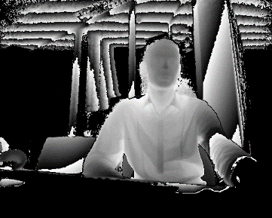
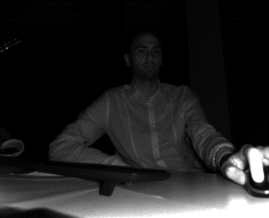

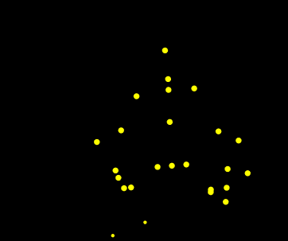
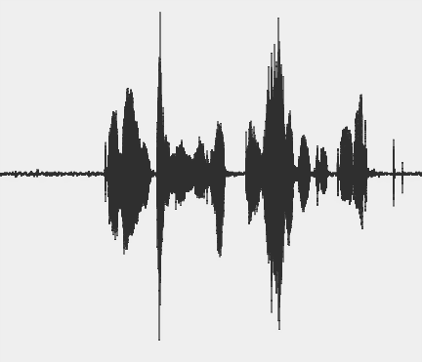
Kinect v2 – Frame source
Color
Depth
Infrared
Body index
Body
Audio

Slide 14
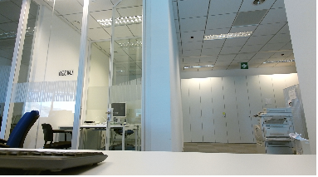
Kinect v2 – Color frame source
1920 x 1080 array of pixel
Different sensor than depth
30 fps
Will maintain brightness and quality by dropping to 15 fps in low-light

Slide 15
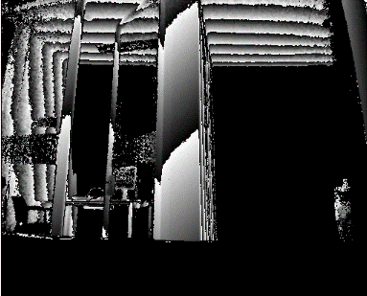
Kinect v2 – Depth frame source
512 x 424 array of pixel
30 fps
Distance range 0.5 – 4.5 meters

Slide 16
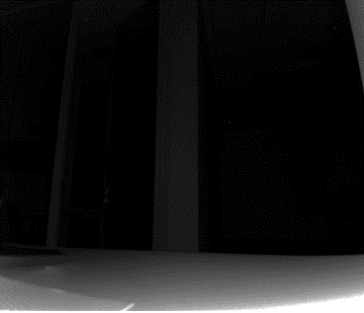
Kinect v2 – Infrared frame source
512 x 424 array of pixel
30 fps
Ambient light removed
From the same physical sensor as depth

Slide 17

Kinect v2 – Body index frame source
512 x 424 array of pixel
Up to 6 simultaneous bodies
30 fps
Same resolution as depth

Slide 18
Kinect v2 – Body frame source
Frame data is a collection of Body object each with 25 joints (each joint has position in 3D space and orientation)
Up to 6 simultaneous bodies
30 fps
Hand state (Open, Closed, Lasso)
Lean

Slide 19
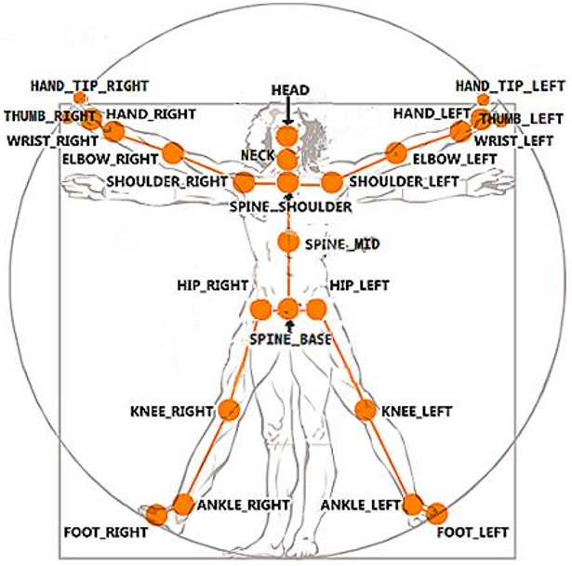
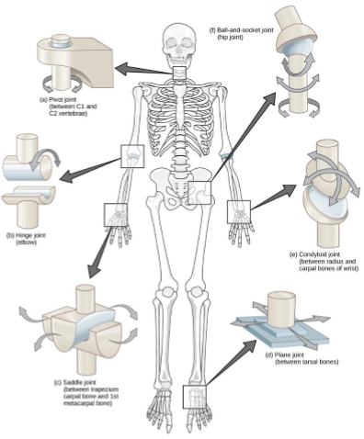
Kinect v2 – Body frame source

Slide 20
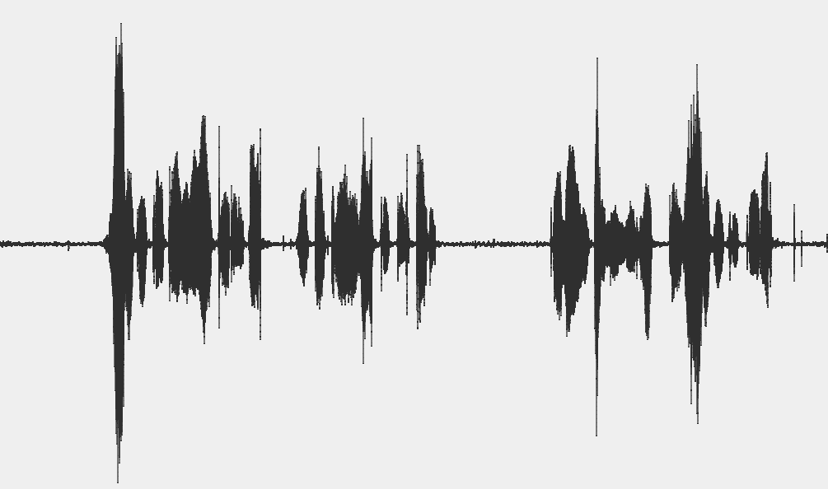
Kinect v2 – Audio source
Data is audio samples captured over a specific interval of time
Audio is associated with an “audio beam”

Slide 21
Kinect v2 – Multi frame source
Allows to get a matched set of frames form multiple source on a single time.
Delivers frames at the lowest fps of the selected sources.

Slide 22
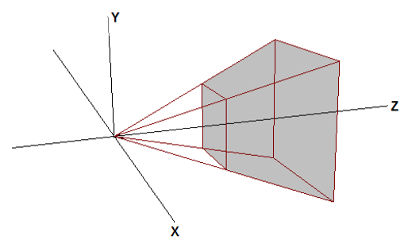
Kinect v2 – Coordinate Mapper
It provides conversion between each systems. It is possible perform single or multiple conversion.
Name | Applies to | Dimension | Units | Range | Origin
ColorSpacepoint | Color | 2 | pixel | 1920x1080 | Top left
DepthSpacePoint | Depth, Infrared, Body index | 2 | pixel | 512x424 | Top left
CameraSpacePoint | Body | 3 | meter | NA | Infrared / Depth camera

Slide 23

Kinect v2 – Application Lifecycle
Add reference to Microsoft.Kinect assembly
First step:
KinectSensor kinectSensor = KinectSensor.GetDefault();
if (!kinectSensor.IsAvailable)
return;
if(!kinectSensor.IsOpen)
kinectSensor.Open();
// CODE HERE
kinectSensor.Close();
Microsoft Kinect NuGet Packages available

Slide 24
Kinect v2 – Basic flow of programming
Sensor
Source
Reader
Frame
Data
KinectSensor.GetDefault().DepthFrameSource.OpenReader().AcquireLatestFrame().CopyFrameDataToArray(frameData);

Slide 25
Kinect v2 – Basic flow of programming
Readers allow to access to the Kinect frame.
It is possible to read the frame via pooling:
var colorFrameReader = kinectSensor.ColorFrameSource.OpenReader();
using (var colorFrame = colorFrameReader.AcquireLatestFrame())
{
if (colorFrame == null)
return;
// CODE HERE
}
var colorFrameReader = kinectSensor.ColorFrameSource.OpenReader(); colorFrameReader.FrameArrived += OnColorFrameReader;
---
private void OnColorFrameReader(object sender, ColorFrameArrivedEventArgs e)
{
using (var colorFrame = e.FrameReference.AcquireFrame())
{
if (colorFrame == null)
return;
// CODE HERE
}
}
or by event:

Slide 26
Kinect v2 – Face Detection and Alinement
Through Kinect Face it is possibile detects body faces point and expression.
Face points:
The user's left eye point
The user's right eye point
The user's nose point
The user's left corner of the mouth point
The user's right corner of the mouth point
Each point can be visualized in color or Infrared space.

Slide 27






Kinect v2 – Face Expression
Face expressions:
The user's happy facial expression
The user's right eye is closed
The user's left eye is closed
The user's mouth is open
The user's mouth has moved since the previous frame
The user is looking at the sensor
The user is wearing glasses

Slide 28
Kinect v2 – Face Detection and Alinement
Add reference to Microsoft.Kinect.Face assembly
Use FaceFrameSource and FaceFrameReader classes
Use FaceFrame class in order to get face information
Microsoft Kinect NuGet Packages available

Slide 29
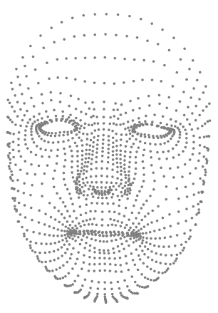

Kinect v2 – High Definition Face
Through Kinect High Definition Face it is possibile detects over 1000 facial points in the 3D space.
1347 facial points
2340 triangles
Hair color
Body color
Face 3D Model
Not sufficiently documented
Many API are available only in C++

Slide 30
Kinect v2 – High Definition Face
Add reference to Microsoft.Kinect.Face assembly
Use HighDefinitionFaceFrameSource and HighDefinitionFaceFrameReader classes
Use HighDefinitionFaceFrame class in order to get high definition face information
Microsoft Kinect NuGet Packages available

Slide 31
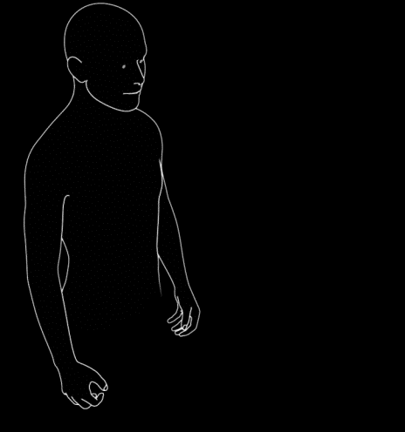



Kinect v2 – Hand Pointer Gestures
Targeting
Press
Panning / Zoom
Engagement

Slide 32
Kinect v2 – Hand Pointer Gestures - Press
Recommended Minimum Size:
208 x 208 (in 1080p resolution)
Press attraction towards center
Larger buttons will just attract away from the edge
Adapting to smaller visual sizes:
Make large-size hit testable
Set KinectRegion.KinectPressInset (Thickness) to non-visible part of button
Attraction region is smaller

Slide 33
Kinect v2 – Hand Pointer Gestures - WPF
Add Reference to Microsoft.Kinect.Wpf.Controls
Add KinectRegion as container for your Windows Control
Run it!

Slide 34
Kinect v2 – Hand Pointer Gestures – Store App
Add Reference to Microsoft.Kinect.Xaml.Controls
Enable Microphone + Camera capabilities in App Manifest
Add KinectRegion as container for rootFrame in App.xaml.cs
Run it!

Slide 35
Demo
Hand Pointer Gestures and Frame source

Slide 36
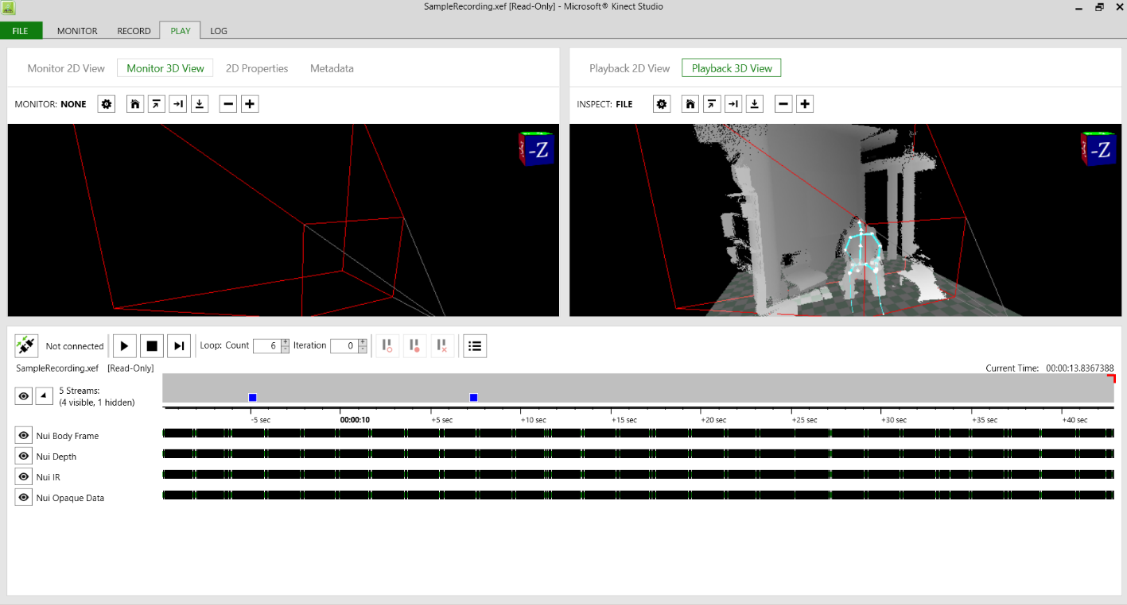
Kinect v2 – Recording and Playback
Kinect Studio
Record sample clip of data from the Kinect v2 device.
Playback a recorded sample clip of data
Play data from a live stream directly from a connected Kinect v2 Device

Slide 37
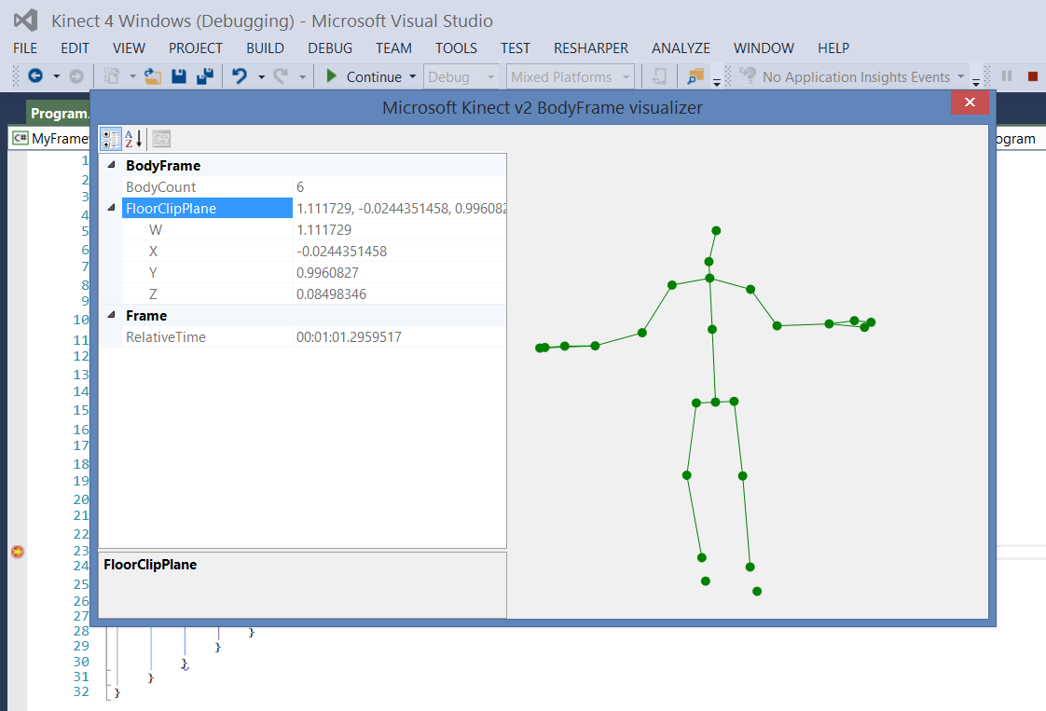
Kinect v2 – Visual Studio Visualizer
Visualizers are components of the Visual Studio debugger user interface. A visualizer creates a dialog box or another interface to display a variable or object in a manner that is appropriate to its data type.
It is possible to create custom visualizer just implementing some .NET interfaces.

Slide 38
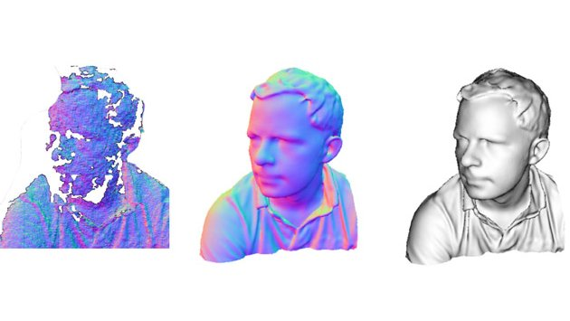
Kinect v2 – Fusion
Microsoft KinectFusion provides 3D object scanning and model creation using a Kinect for Windows sensor. The user can paint a scene with the Kinect camera and simultaneously see, and interact with, a detailed 3D model of the scene.

Slide 39
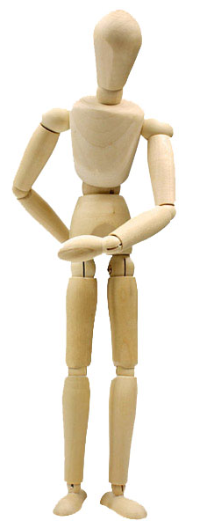
Kinect v2 – Custom gesture / pose
Inside Kinect v2 SDK it is available a tool that allow you to create custom gesture.
Visual Gesture Builder
It is possible define discrete or continuous gesture using Machine Learning technology
Adaptive Boosting (AdaBoost) Trigger: Determine if player is performing a gesture
Random Forest Regression (RFR) Progress: Determine the progress of the gesture performed by the player

Slide 40
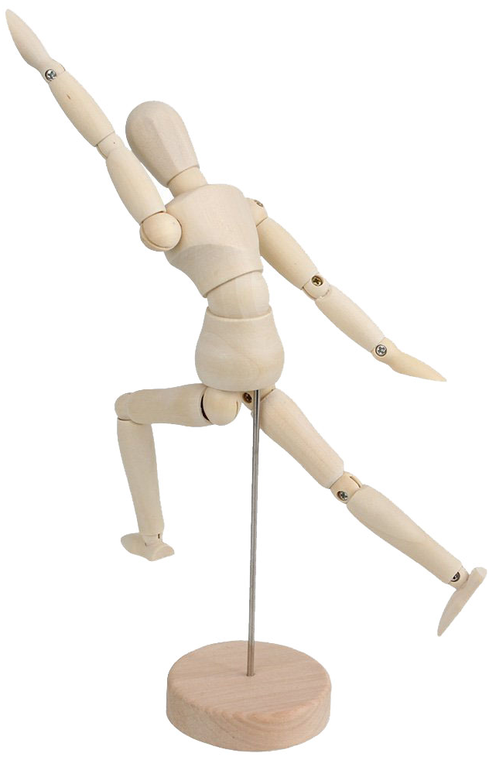
Kinect v2 – Custom gesture / pose
Visual Gesture Builder
Organize data using Project/Solution
Give meaning to data by tagging gesture
Build gesture using Machine Learning technology
Analyze & Test the result of the gesture detection
Live preview of result

Slide 41
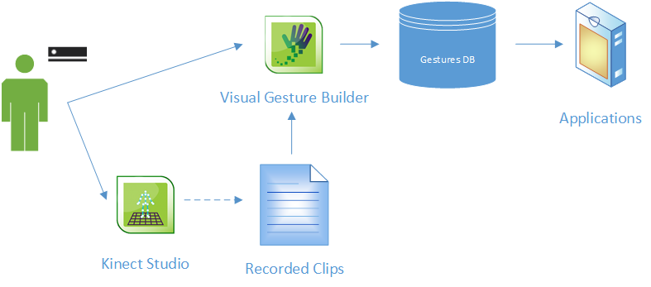
Kinect v2 – Visual Gesture Builder
Basic steps for using Visual Gesture Builder:
Create a solution.
Create one or more projects.
Add a set of clip files to each project.
Tag the frames in the clip files associated with each gesture.
Build a training gesture database.
Use the built gesture database into your application.

Slide 42
Kinect v2 – Custom gesture/pose
Heuristic
ML with Visual Gesture Builder
Gesture is a coding problem
Quick to do simple gestures/poses (hand over head)
ML can also be useful to find good signals for Heuristic approach
Gesture is a data problem
Signals which may not be easily human understandable (progress in a baseball swing)
Large investment for production
Danger of over-fitting, causes you to be too specific – eliminating recognition of generic cases

Slide 43
Demo
Custom Gestures

Slide 44



Kinect v2 – Other Framework

Slide 45
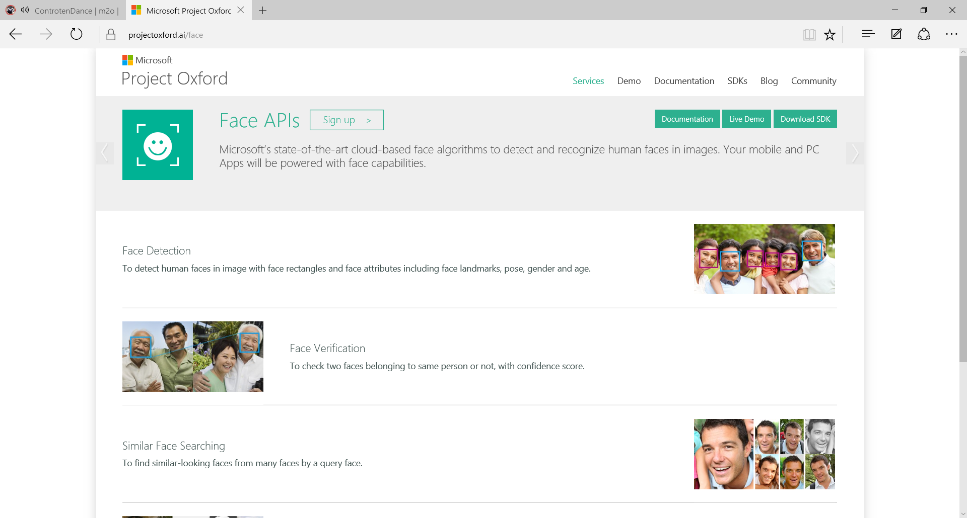


Kinect v2 – Other Framework
Face APIs
Computer Vision APIs

Slide 46
Kinect v2 – Official Resources
General Info & Blog
http://kinectforwindows.com
Developer Forums
http://aka.ms/k4wv2forum
Download Kinect v2 SDK
http://aka.ms/k4wv2sdk
Twitter
@KinectWindows

Slide 47
Intel Realsense Camera & SDK

Slide 48


Notes:
Explorar o público (colocar essas perguntas na pesquisa final)
Quem conhece RealSense?
Quem desenvolve utilizando o RealSense SDK versão 2014?
Quem desenvolve outros SDKs que trabalham com este tipo de tecnologia? (Leap Motion, Kinect, etc)

Slide 49
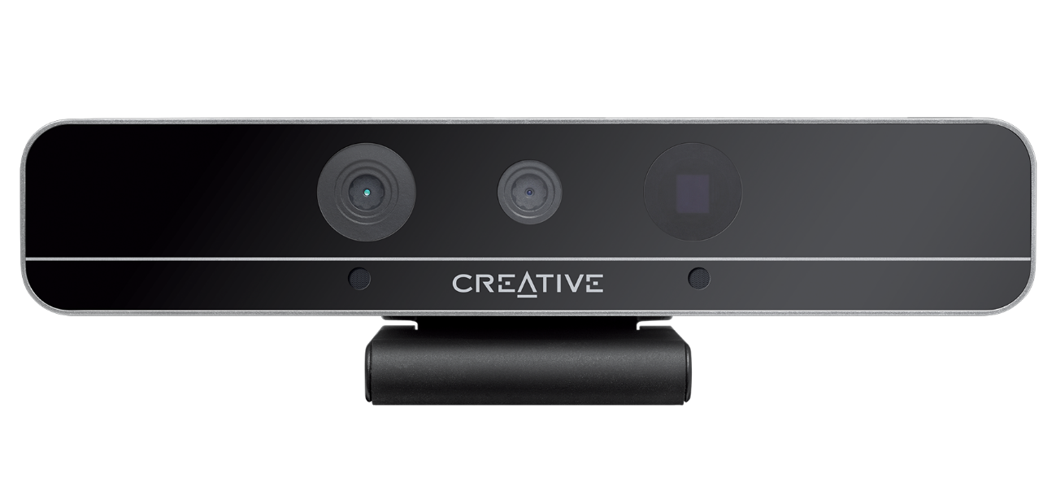
Intel® RealSense™ 3D Camera F200
Notes:
A principal câmera que temos no momento é a F200 que vocês podem ver nessa foto.

Slide 50
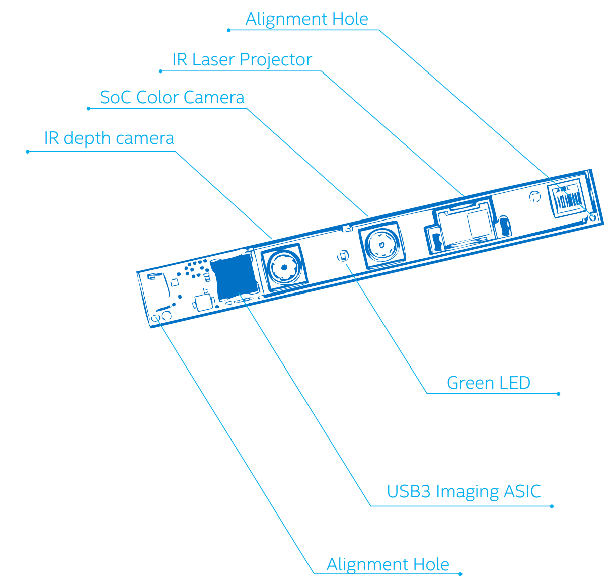
F200 Camera Specs
Spec | Color | Depth (IR)
Resolution | 1080p | VGA
Aspect Ratio | 16:9 | 4:3
Frame Rate | 30/60/120 FPS
FOV (D X V X H) | 77º x 43º x 70º | 90º x 59º x 73º
Other
Effective Range | 0.2 – 1.2 m
Environment | Indoor/Outdoor
Notes:
Color Camera
Resolution: 1080p@30FPS (FHD)
Active Pixels: 1920x1080 (2M)
Aspect Ratio: 16:9
Frame Rate: 30/60/120 FPS
Field of View: 77º x 43º x 70º (Cone) (D x V x H)
Color Formats: YUV4:2:2 (Skype/Lync Modes**)
Depth (IR) Camera
Resolution: 640x480@60FPS (VGA), HVGA@120FPS
640x480@120FPS (IR)
Active Pixels: 640x480(VGA)
Aspect Ratio: 4:3
Frame Rate: 30/60/120 FPS (Depth)
120FPS (IR)
Field of View: 90º x 59º x 73º (Cone)
IR Projector FOV: N/A x 56º x 72º (Pyramid)
Color Formats: N/A

Slide 51
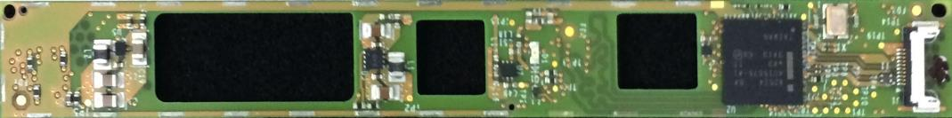



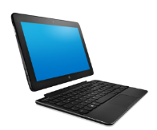


Where to find the Intel® RealSense™ technology?
Notes:
Onde está o RealSense?
Até o ano passado estivemos trabalhando com o ecosistema para distibuir kits de desenvolvimento e garantir que desenvolvedores como vocês começassem a criar usos bacanas para essa tecnologia.
E agora estamos trabalhando para espalhar o RealSense por vários devices junto com vários parceiros do ecosistema para que os primeiros devices cheguem ao mercado entre 2014 e 2015. Inclusive alguns já foram anunciados na CES: mostram alguns deles.

Slide 52


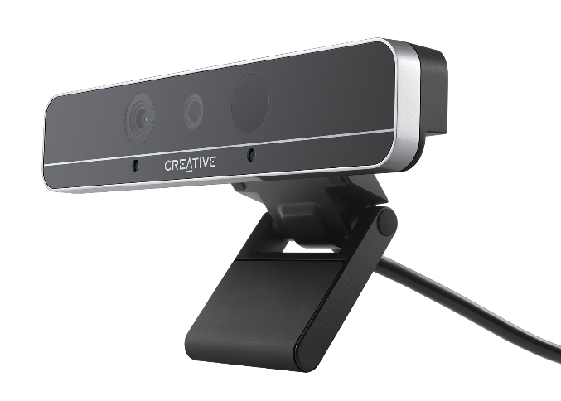
Intel® RealSense™ 3D Cameras
Intel® RealSense™ 3D Camera (Front F200)
Intel® RealSense™ Snapshot
Intel® RealSense™ 3D Camera (Rear R200)
Notes:
Basicamente trabalhamos com duas partes:
A Intel RealSense 3D Camera
Intel RealSense SDK
Mas além disso estamos trabalhando em duas câmeras adicionais para ampliar os modelos de uso e possibilidade de integração, e teremos:
R200 Snapshot: camera mais simples com foco em telefones e tablets e uso mais casual. Trabalha com pós processamento das imagens depois da captura. Sim é a camera que esta no tablet da Dell.
R200: a F200 é uma camera com objetivo de capturar interações com o usuário (Front or User Facing). Já a R200 é conhecida como World Facing camera e tem a proposta de capturar informações sobre o ambiente onde o device esta inserido.
F200: Interações naturais, imersivas, colaboração, jogos, aprendizagem e scaneamento 3D
Snapshot: Medições de distância, foco e cor, filtros de movimento
R200: Realidade Aumentada, criação de conteúdo, scaneamento de objetos

Slide 53


Notes:
Explorar o público (colocar essas perguntas na pesquisa final)
Quem conhece RealSense?
Quem desenvolve utilizando o RealSense SDK versão 2014?
Quem desenvolve outros SDKs que trabalham com este tipo de tecnologia? (Leap Motion, Kinect, etc)

Slide 54

Free tools and APIs to develop apps with NUI in a simple way
Focus where is important: the content
Acessible for beginners and extensible for experts
Notes:
APIs e ferramentas para implementação de NUI
Acessível para iniciantes e extensível para experts
Foco do app aonde mais importa: conteúdo

Slide 55
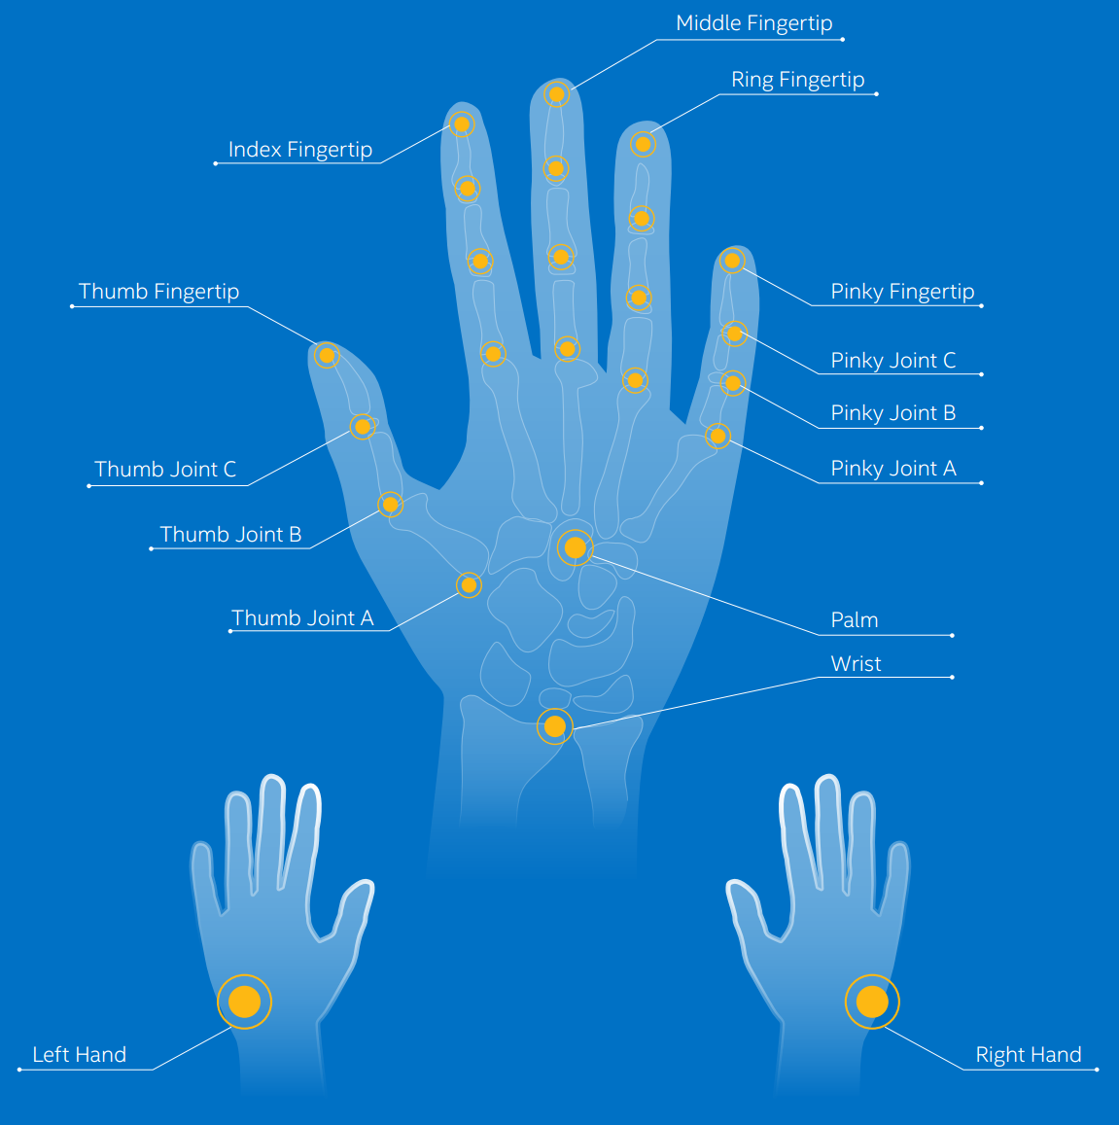
Hands - Tracking and Joints
22 Joints
Detects Body Side
Tracks X, Y and Z positions from detected hands
Notes:
Arrumar fundo azul da imagem **
Reference Links:
https://software.intel.com/sites/landingpage/realsense/camera-sdk/2014gold/documentation/html/manuals_programming_guide_gesture.html
https://software.intel.com/sites/landingpage/realsense/camera-sdk/2014gold/documentation/html/manuals_programming_guide_gesture.html
https://software.intel.com/sites/landingpage/realsense/camera-sdk/2014gold/documentation/html/manuals_general_procedure_2.html
https://software.intel.com/sites/landingpage/realsense/camera-sdk/2014gold/documentation/html/manuals_hand_calibration_data.html
https://software.intel.com/sites/landingpage/realsense/camera-sdk/2014gold/documentation/html/manuals_alternative_hand_tracking_solu.html
Em Rastreamento e Pontos, podemos colher os dados de cada um dos 22 pontos, sabendo também qual o lado do corpo (esquerda ou direira) pertencem.

Slide 56
Hands – Gestures and Poses
Notes:
Reference Links:
https://software.intel.com/sites/landingpage/realsense/camera-sdk/2014gold/documentation/html/manuals_pose_and_gesture_recognition.html
https://software.intel.com/sites/landingpage/realsense/camera-sdk/2014gold/documentation/html/manuals_gesture_interaction_guide.html
** ERRO NAS IMAGENS ** TAP GESTURE
Aqui observamos os gestos que compõem a RealSense SDK:
SpreadFingers ou Big5, gesto estático, o mais simples identificando uma mão aberta;
V-Sign, ou mais conhecido V de vitória. Também estático;
Tap, representa um gesto dinâmico de pressionar;
Wave, gesto dinâmico que representa para nós um “tchau”;

Slide 57
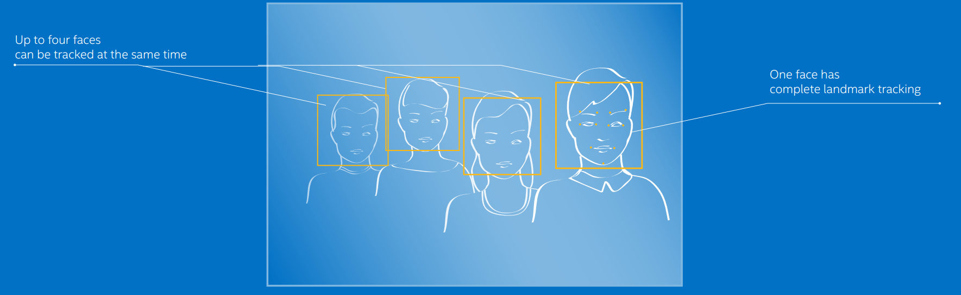
Face – Tracking
Tracking ( 4 faces)
Landmarks Tracking (1 Face)
X, Y, Width and Height
Average Depth
Notes:
TENTAR ARRUMAR FUNDO AZUL*
https://software.intel.com/sites/landingpage/realsense/camera-sdk/2014gold/documentation/html/manuals_general_procedure_face.html
https://software.intel.com/sites/landingpage/realsense/camera-sdk/2014gold/documentation/html/manuals_general_procedure_face.html
https://software.intel.com/sites/landingpage/realsense/camera-sdk/2014gold/documentation/html/manuals_face_location_data.html
Ilustração da detecção de rostos. No máximo 4 rostos podem ser detectados ao mesmo tempo. Apenas 1 desses 4 podem ter todos os pontos do rosto rastreados (landmarks).
Mostrar Implementação

Slide 58
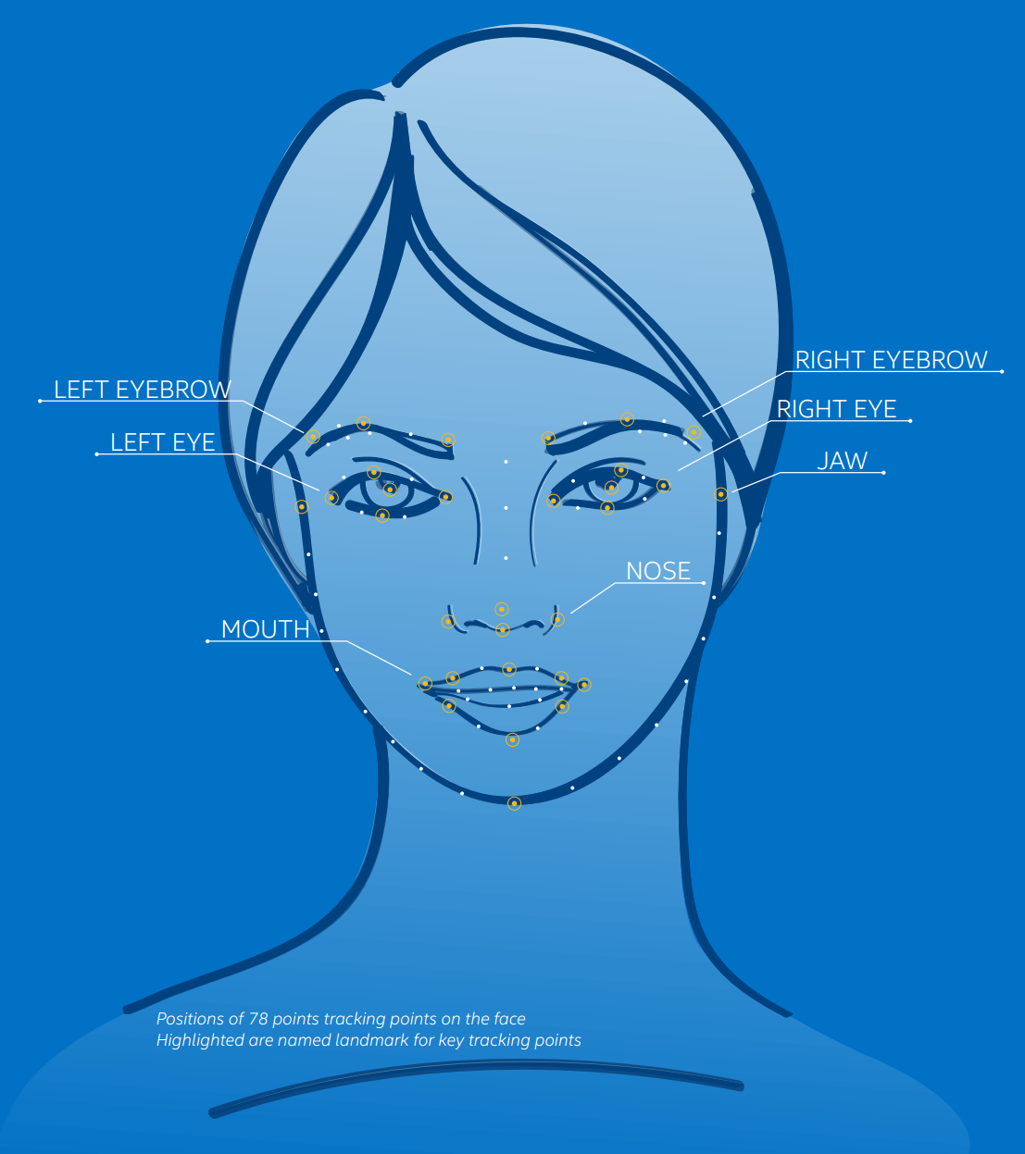
Face – Landmarks
78 landmark points:
Nose
Mouth
Jaw
Eyes
Eyebrows
Notes:
TENTAR ARRUMAR FUNDO AZUL**
https://software.intel.com/sites/landingpage/realsense/camera-sdk/2014gold/documentation/html/manuals_face_landmark_data.html
Ao todo podem ser detectados 78 pontos no rosto, dividindo-se nos seguintes grupos:
Nariz;
Boca;
Mandíbula;
Olho (esquerdo e direito);
Sombrancelha (esquerda e direita).
Mostrar Implementação

Slide 59
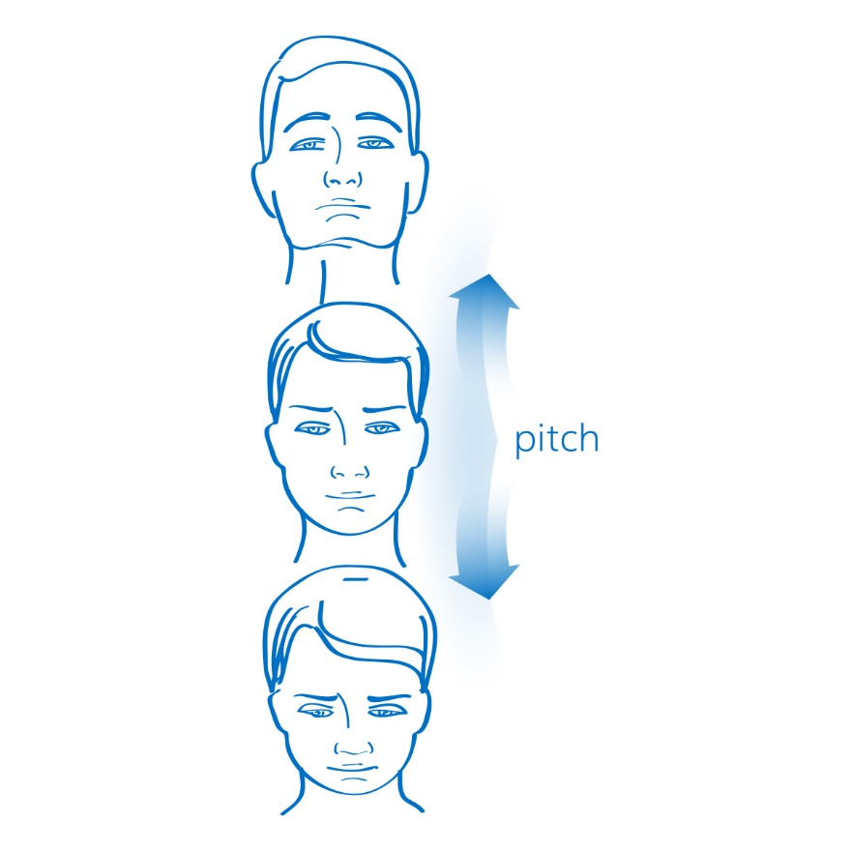
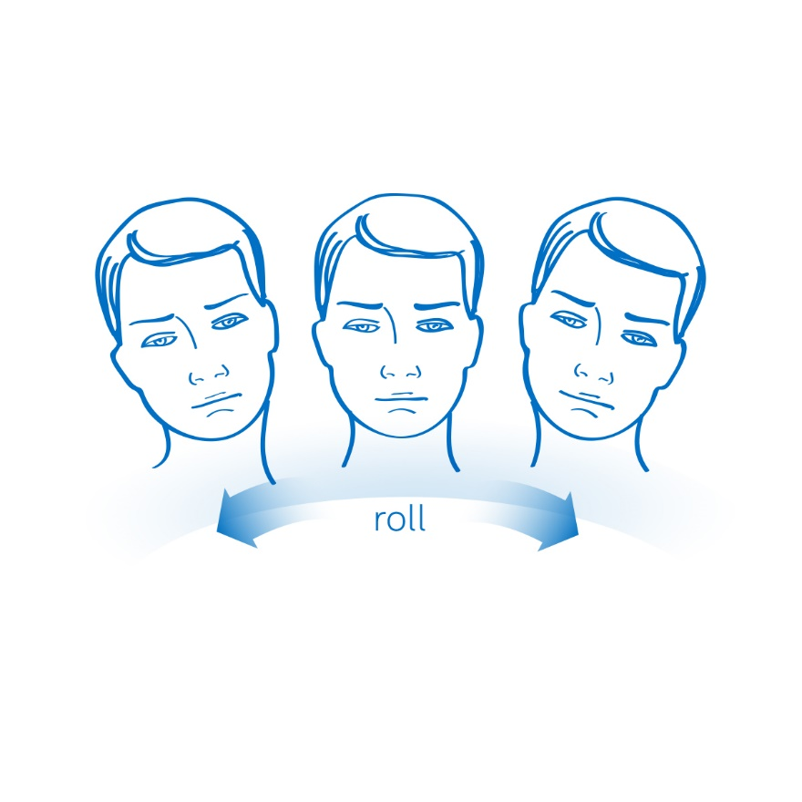
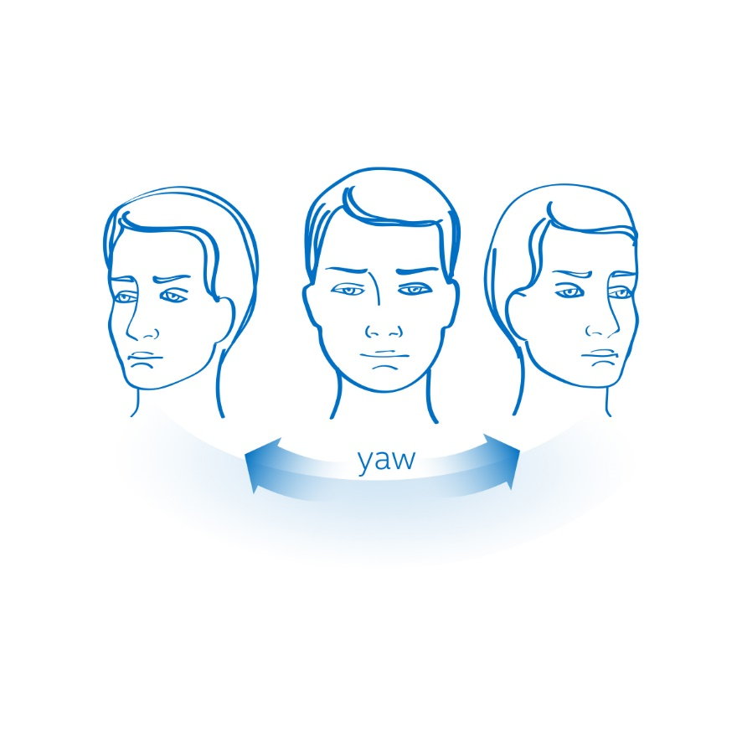
Face – Pose
Notes:
Tentar arrumar fundo azul ****
https://software.intel.com/sites/landingpage/realsense/camera-sdk/2014gold/documentation/html/manuals_face_pose_data.html
Ilustração dos ângulos X,Y,Z da cabeça:
Pitch (y), para cima e para baixo;
Yaw (x), olhar para esquerda ou direita;
Roll (z), movimentar cabeça para esquerda ou para direita, mantendo X e Y. ** melhorar descrição...
Mostrar Implementação

Slide 60
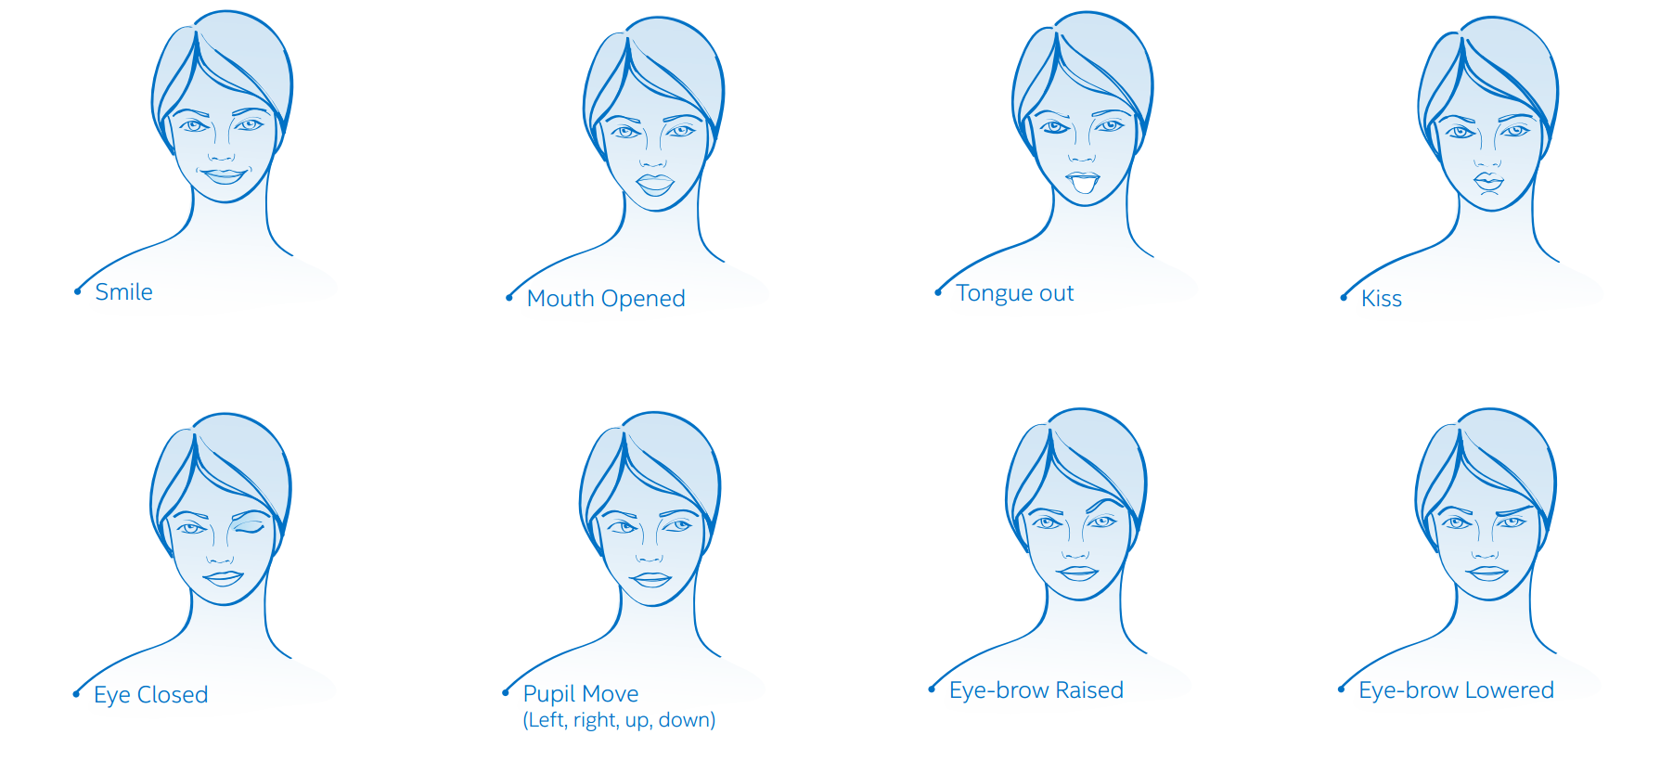
Face – Expressions
Notes:
https://software.intel.com/sites/landingpage/realsense/camera-sdk/2014gold/documentation/html/manuals_facial_expression_data.html
Expressões Faciais;
Em uma forma geral conseguimos captar, através do módulo Face, 8 expressões faciais (com a intensidade aplicada):
Sorriso;
Boca aberta;
Beijo (?), Duck face :^
Olho fechado (esquerdo e direito);
Movimento das pupilas (esquerda,direita, cima, baixo) de cada olho;
Sombrancelha levantada (esquerda e direita);
Sombrancelha abaixada (?) (esquerda e direita);
Mostrar implementação...

Slide 61
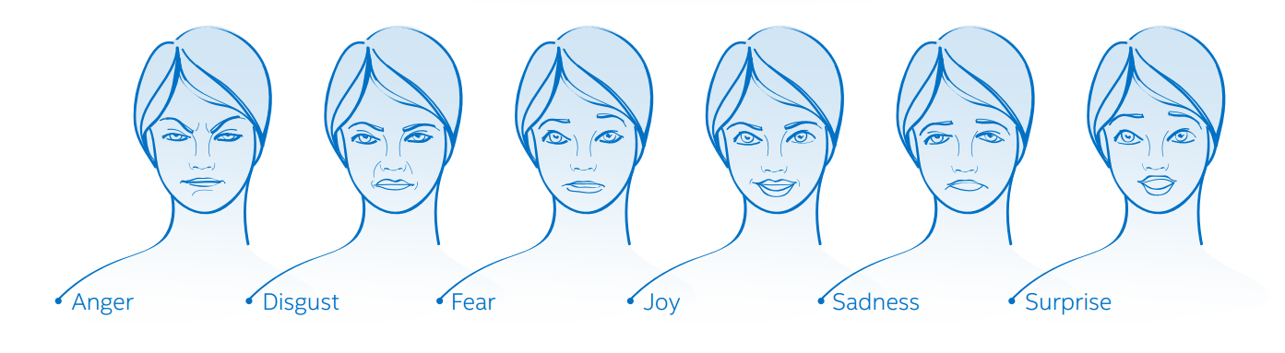
Face – Emotions (Experimental)
Notes:
https://software.intel.com/sites/landingpage/realsense/camera-sdk/2014gold/documentation/html/manuals_emotion_detection_via_senseman.html
Apesar de ainda experimental, implementamos um sample utilizando o módulo de emoções. OBS: ele fica separado do módulo Face.
Baseando nas expressões detectadas, o algoritmo tenta prever as emoçõs do usuário, apresentando a intensidade de cada uma.
6 emoções podem ser detectadas:
Irritado (ou Raiva);
Descontente;
Com medo;
Alegre;
Triste;
Surpreso.
Mostrar implementação...

Slide 62
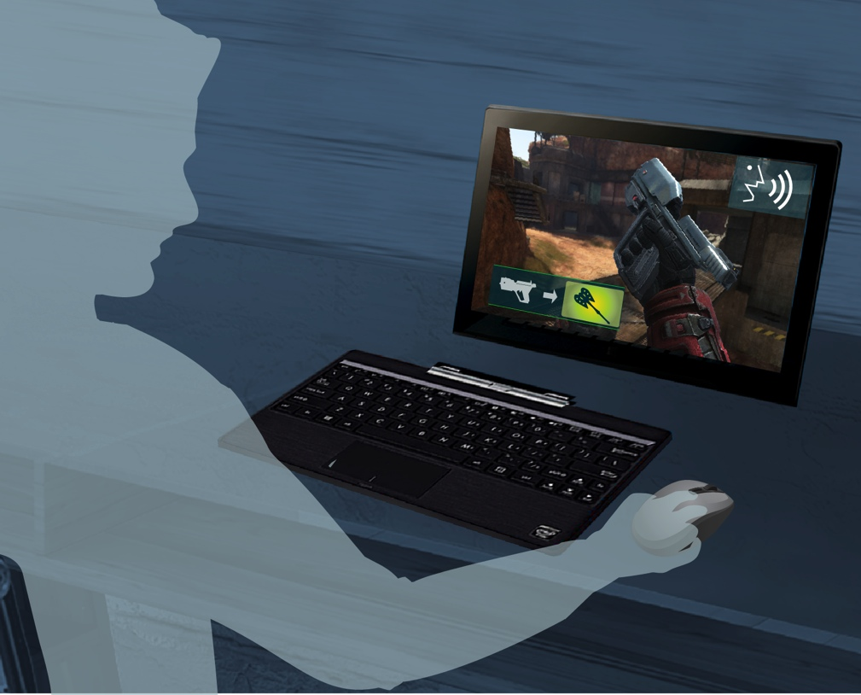
Speech – Recognition
Switch Weapon!
Notes:
Reference links:
https://software.intel.com/sites/landingpage/realsense/camera-sdk/2014gold/documentation/html/manuals_speech_recognition_procedure.html
https://software.intel.com/sites/landingpage/realsense/camera-sdk/2014gold/documentation/html/manuals_command_control_and_dictation.html
https://software.intel.com/sites/landingpage/realsense/camera-sdk/2014gold/documentation/html/manuals_handle_recognition_events.html
https://software.intel.com/sites/landingpage/realsense/camera-sdk/2014gold/documentation/html/manuals_about_audio_recording_level.html
https://software.intel.com/sites/landingpage/realsense/camera-sdk/2014gold/documentation/html/manuals_about_confidence_level.html
Neste modo, dizemos quais os comandos podem ser pronunciados, fazendo então um filtro para o algoritmo de detecção.
Um exemplo de uso seria o comando “play” para tocar uma música na sua aplicação.

Slide 63

Speech – Synthesis
Your Score is: Five Hundred and Sixty Five!
Notes:
https://software.intel.com/sites/landingpage/realsense/camera-sdk/2014gold/documentation/html/manuals_speech_synthesis.html
Basicamente um text-to-speech. Definimos o texto a ser falado e o módulo encarrega-se de reproduzir através do AudioManager instanciado.

Slide 64
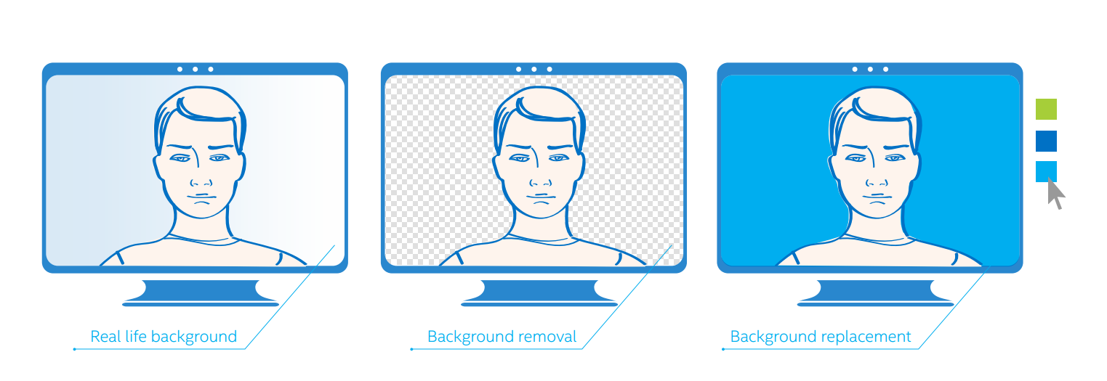
Segmentation
Notes:
https://software.intel.com/sites/landingpage/realsense/camera-sdk/2014gold/documentation/html/manuals_user_segmentation.html
O módulo de segmentação encarrega-se de gerar as imagens removendo boa parte do background. Feita a remoção, podemos adicionar o fundo que queremos via código.

Slide 65

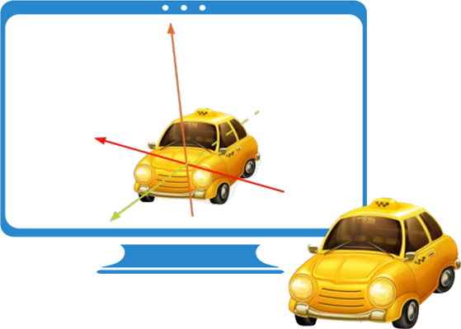
Object Tracking
2D
3D
Notes:
Reference Links:
https://software.intel.com/sites/landingpage/realsense/camera-sdk/2014gold/documentation/html/manuals_object_tracking.html
https://software.intel.com/sites/landingpage/realsense/camera-sdk/2014gold/documentation/html/manuals_object_tracking_via_sense_manager.html
https://software.intel.com/sites/landingpage/realsense/camera-sdk/2014gold/documentation/html/manuals_configuration_and_tracking_dat.html
https://software.intel.com/sites/landingpage/realsense/camera-sdk/2014gold/documentation/html/manuals_the_metaio_toolbox.html
Temos dois modos de rastreamento de objetos: 2d e 3d
Iremos mostrar uma implementação do Object Tracking 2d. Passamos uma imagem/foto do objeto (no caso uma tag), carregamos nas configurações do módulo e o mesmo se encarrega de rastrear.
Devemos lembrar que, para o reconhecimento de objetos (3d ou 2d), devemos antes de tudo calibrar a câmera (podemos mostrar como fazer isso, mas depende do tempo que tivermos);

Slide 66

3D Scanning
Notes:
Reference Links:
https://software.intel.com/sites/landingpage/realsense/camera-sdk/2014gold/documentation/html/manuals_object_tracking.html
https://software.intel.com/sites/landingpage/realsense/camera-sdk/2014gold/documentation/html/manuals_object_tracking_via_sense_manager.html
https://software.intel.com/sites/landingpage/realsense/camera-sdk/2014gold/documentation/html/manuals_configuration_and_tracking_dat.html
https://software.intel.com/sites/landingpage/realsense/camera-sdk/2014gold/documentation/html/manuals_the_metaio_toolbox.html
Temos dois modos de rastreamento de objetos: 2d e 3d
Iremos mostrar uma implementação do Object Tracking 2d. Passamos uma imagem/foto do objeto (no caso uma tag), carregamos nas configurações do módulo e o mesmo se encarrega de rastrear.
Devemos lembrar que, para o reconhecimento de objetos (3d ou 2d), devemos antes de tudo calibrar a câmera (podemos mostrar como fazer isso, mas depende do tempo que tivermos);

Slide 67
Microsoft Passport e Windows Hello

Slide 68
Going beyond passwords
Problems:
Passwords are hard to remember
Passwords are re-used -> server breach attacks
Microsoft passport solution:
User has to remember only one PIN or can use Windows Hello
No secret is stored on servers -> Two factor authentication with asymmetric keys

Slide 69
Windows 10 and Microsoft Passport Simple for Developer
Reduces the cost associated with password compromise and reset
Native API support for strong authentication via Universal Windows Platform
JavaScript API support for browsers coming later this year.

Slide 70
Windows Hello: Sensor Support
Fingerprint
All current fingerprint capable devices are supported
Face
All current (f200) and future Intel® RealSense™ are supported for Windows Hello face authentication
All devices that include an IR sensor that meets Microsoft sensor spec
Iris
A selection of devices will be arriving to market within the next 12 months
More details on sensor requirements and support coming soon

Slide 71

Windows Hello
Windows 10 support three type of biometric Auth:
Fingerprint
Face
Iris
All of three provide gesture and action recommended on the hardware supported
Integrated with the Windows Biometric Framework
use the same scenary and experience
Share the same language for use and definition

Slide 72
Microsoft Passport: Provisioning
Two Step Verification
Create Microsoft Passport
Register Public key with Server
KeyCredentialRetrievalResult kcResult = await
KeyCredentialManager.RequestCreateAsync(accountID, KeyCredentialCreationOption.FailIfExists);
IBuffer userPublicKey = kcResult.Credential.RetrivePublicKey();

Slide 73
Microsoft Passport: Usage
Open Microsoft Passport
Sign challenge from Server with Microsoft Passport
Send digital signature to server
KeyCredentialRetrievalResult kcResult = await KeyCredentialManager.OpenAsync(accountID);
KeyCredentialOperationResult kcOpResult = await kcResult.Credential.RequestSignAsync(serverChallenge);

Slide 74
Microsoft Passport: Deletion
Open Microsoft Passport
Delete Passport
Delete Public Key on Server
KeyCredentialRetrievalResult kcResult = await KeyCredentialManager.OpenAsync(accountID);
KeyCredentialManager.DeleteAsync(accountID);

Slide 75
DEMO SharpSenses

Slide 76
Reference
Build Session
Microsoft Passport and Windows Hello: Moving Beyond Passwords and Credential Theft
https://channel9.msdn.com/events/Build/2015/2-639
API
Windows.Security.Credentials namespace
Https://msdn.microsoft.com/en-us/library/windows/apps/windows.security.credentials.aspx

Slide 77
Q&A

Slide 78
Thank you!
Notes:
Colocar contatos: Carrara, Felipe e João Pedro

